Slide 1
Becoming an Influencer in Your Organization

Slide 2
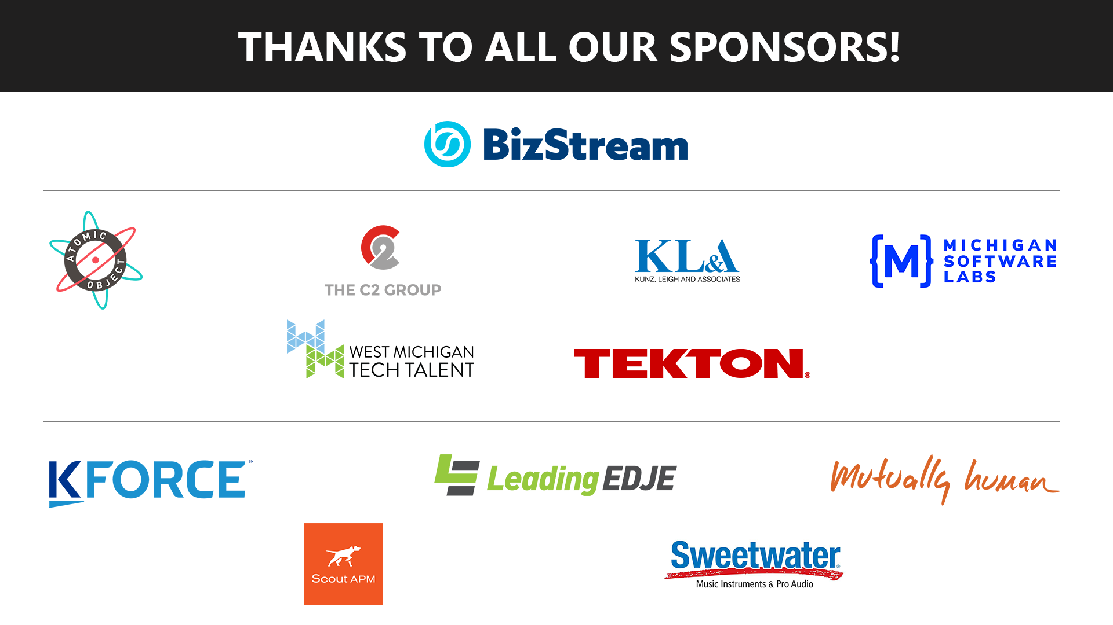

Slide 3
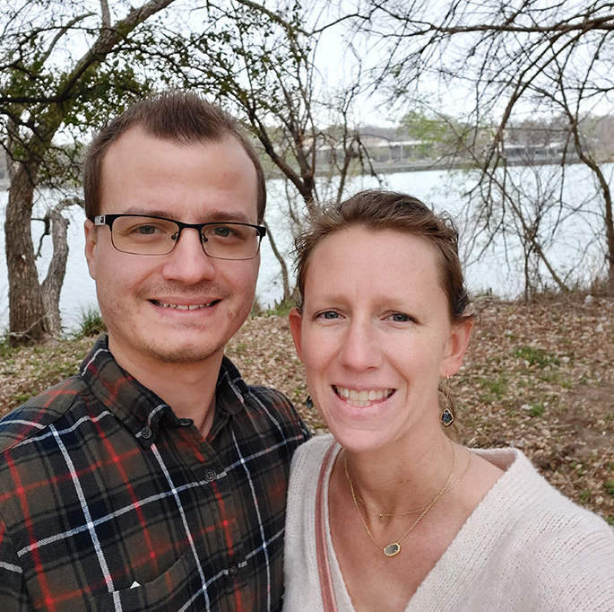
About Me
Director of Technology & Operations, Partner, LimeLight Marketing
Associate Instructional Professor, Pittsburg State University
Pluralsight Author
K-12 Programming Curriculum Developer/Advocate
Uber Driver
Email: john.kuefler@limelightmarketing.com
Twitter: @john_kuefler91

Slide 4





Slide 5
Our Agenda
Why this matters
Influence fundamentals
Definitions
Empathy
Persuasion Science
Communicating skillfully
Methodologies
Your communication style
Barriers to progression
Anxiety
Ego

Slide 6
Technical Skill
Knowledge
Influence
Organizational Leadership

Slide 7
Influence can be defined as the ability to affect the character, development, or behavior of someone or something, and it requires developing a strong emotional connection with yourself and others.
Those who master the art of influence are often skilled at tapping into the emotions that drive people’s actions. This explains why influence is synonymous with leadership.
https://hbr.org/2020/08/strengthen-your-ability-to-influence-people

Slide 8
Influence vs Persuasion

Slide 9
Influence is moving another person toward an action without the use of direct power – getting them to want to do it on their own.

Slide 10
Persuasion is convincing or directing someone to take an action on your behalf, typically with the use of direct power.

Slide 11
The Influencing Process
1. Align
2. Connect
3. Involve
Real Influence; 2013; By Mark Coulston & John Ullmen

Slide 12
Tell me and I’ll forget
Show me and I may remember
Involve me and I’ll understand
- Ben Franklin

Slide 13
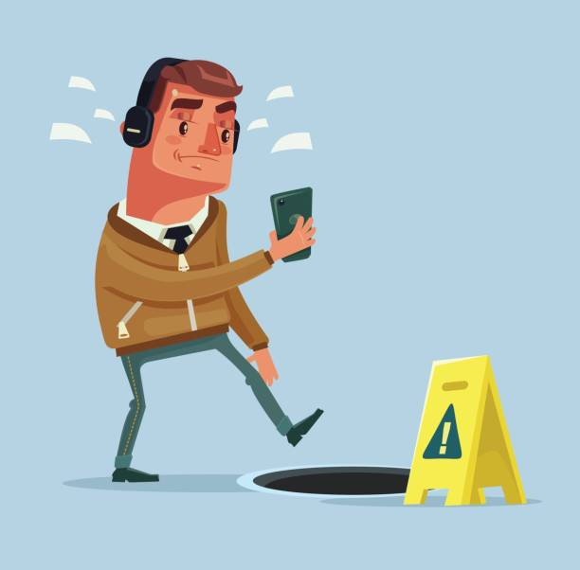
Align
Alignment sidesteps our own strong POV, which has blind spots
How powerful is our singular focus?
https://www.youtube.com/watch?v=IGQmdoK_ZfY

Slide 14
Align: Empathize
Move from simply being dead set on your idea and start asking questions:
Why might the other person care about this topic?
Why are they doing it one way currently and not the way I’m promoting
How might this be threatening to that person?
What do they know that I don’t?
Why would a rational person say “No?”
How could I make this idea visual to make it easier to clarify?
Overall: make it about them, not about you

Slide 15

Empathy vs Sympathy
More about empathy
Notes:
Sympathy is understanding someone else's situation from your own perspective

Slide 16
3 Types of Empathy
Cognitive Empathy
“Simply knowing how the other person feels and what they might be thinking. Sometimes called perspective-taking.”
Emotional Empathy
“When you feel physically along with the other person, as though their emotions were contagious.”
Empathic Concern
“With this kind of empathy we not only understand a person’s predicament and feel with them, but are spontaneously moved to help, if needed.”
https://takealtus.com/2020/06/empathy-1

Slide 17
Connect
Using insight gained from alignment/empathy, build a bridge:
What if we built on YOUR idea in this way?
Help me to understand the problem you're solving for so that we can find a solution together
Can I get YOUR input on ideas that I’ve sketched out?

Slide 18
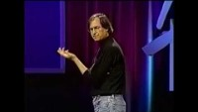

Slide 19

Connect
Tip: use cognitive artifacts
“A cognitive artifact is something physical or digital that has aided a mental process.”
Why does this help?
https://www.interaction-design.org/literature/topics/cognitive-artifacts

Slide 20

Involvement comes naturally through the alignment and connection process

Slide 21
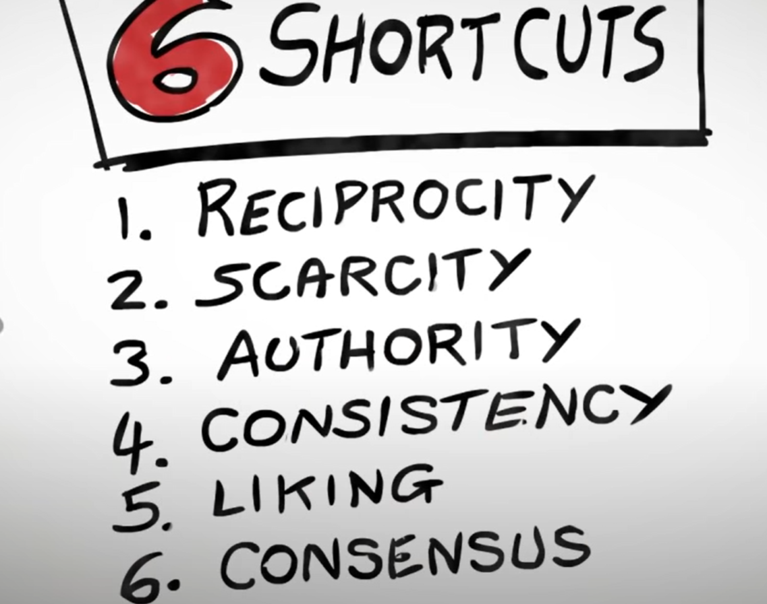
Types of Persuasion
Use persuasion tactics with caution
Build up influence equity, and only make a deposit against it when you can afford it
The Psychology of Persuasion, Robert B. Cialdini, 1984; https://www.youtube.com/watch?v=cFdCzN7RYbw
Notes:
Reciprocity Obligation to give when you receive.
Key: Be the first to give; Make it personalized and unexpected
Scarcity People want more of the things they can have less of.
Key: Focus on the unique benefits and what they stand to lose
Authority People follow the lead of credible, knowledgeable experts.
Key: Signal to others what makes you an expert before you attempt to influence
Consistency People like to be consistent with previous behaviors & actions.
Key: Ask for small commitments to new behaviors before requesting larger ones
Liking We respond best to people who are like us, complement us, and cooperate with us.
Key: Seek”common ground.” Share genuine complements.
Consensus People will look to the actions of others to determine their own.
Key: Highlight what many “similar” others are already doing

Slide 22
Applying Influence: Pitching
Classically, there are 3 main elements to inject into a pitch to make it effective:
Ethos: Credibility and expertise
Logos: Reason, logic, data
Pathos: Emotional resonance
Even pitches that lack just one of these fall flat

Slide 23
Pitching Cont’d
You can apply a framework such as this for successfully pitching/presenting:
Instill your credibility and highlight your experience first:
“Here’s just a few ways that we’ve been successful in the past“
Bring feelings into play – make ideas visual and strive for a connection:
“Imagine if we did…” or “Let me show you how we could…”
Provide facts and data to support why your idea works
“The analytics show that…” or “Research and analysis of customers/competitors shows that…”

Slide 24


Slide 25

Understand Your Communication Style
Why?
Learn areas where you are strong and weak
Attempt to recognize the styles of others
Learn to alter your own communication style to better communicate with others

Slide 26
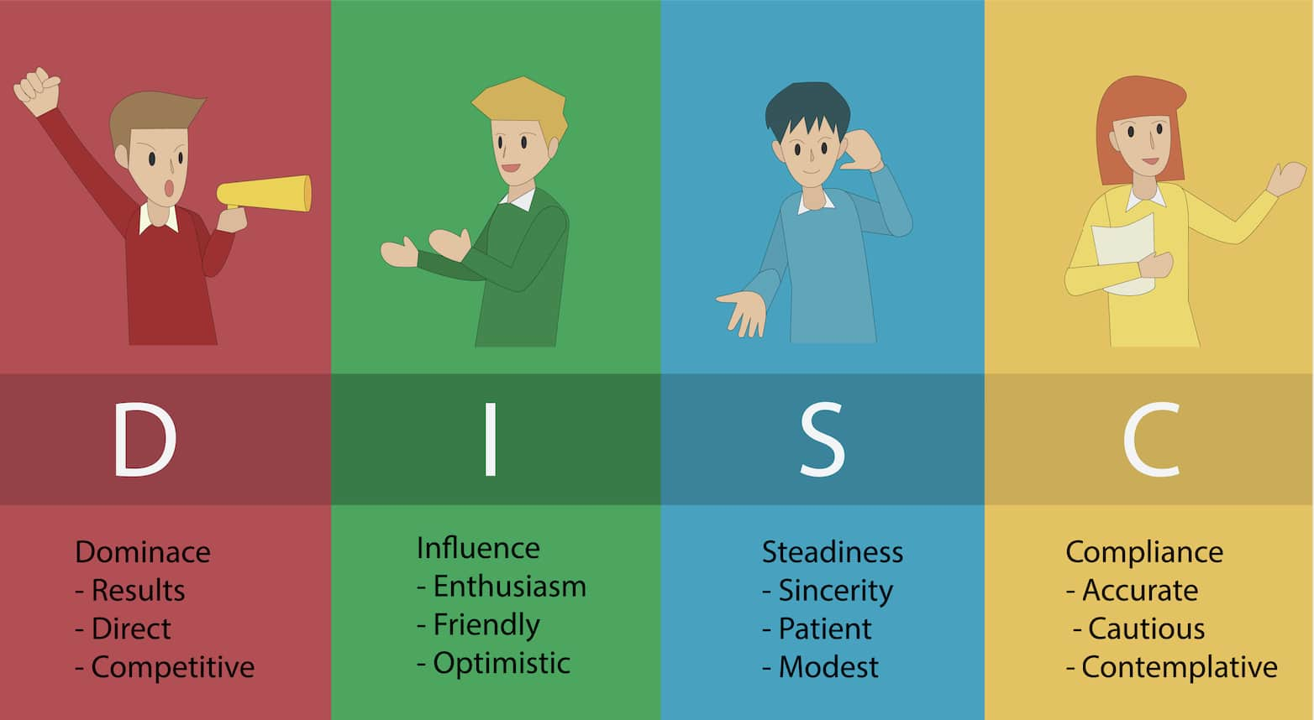
https://stephenscoggins.com/how-to-use-your-disc-communication-style/

Slide 27
Communication Barrier: Anxiety
Anxiety prevents us from achieving our potential, whether in the form of “imposter syndrome” or worrying too much to share our ideas.
Anxiety is our focus on the space between the worst case scenario and the best case scenario that we’ve come to in our own mind.
One tip for overcoming anxiety – you’re wrong about the best and worst case scenario most of the time.

Slide 28
Communication Barrier: Ego
“Everyone else is the problem”. “Why can’t they see why my ideas are so great”. “I can’t believe others are working this way”
Our “egosystems” are one of the biggest causes of our failures. We tend to be at the mercy of this system rather than controlling it, and almost never realize.
Ego Free Leadership: Ending the Unconscious Habits that Hijack Your Business: Brandon Black;Shayne Hughes

Slide 29
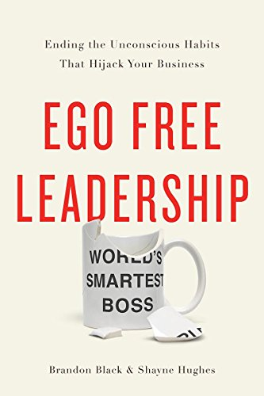

Slide 30
Questions?

